Slide 1
Sensory Processing & Praxis
In High-Functioning Children with Autism
L. Diane Parham, PhD, OTR, FAOTA
Zoe Mailloux, MA, OTR, FAOTA
Susanne Smith Roley, MS, OTR

Slide 2
Purpose
To describe the patterns of sensory processing and praxis that are characteristic of children with autism
Lay the groundwork for a fuller understanding of how sensory processing and praxis influence the occupations of individuals with autism

Slide 3
Participants
20 children with autism spectrum disorder and IQ within normal limits
20 children without disabilities, matched on age, gender, and ethnicity
Mean age: 8 years, 1 month

Slide 4
Instrument
Sensory Integration and Praxis Tests (SIPT) administered to all participants

Slide 5
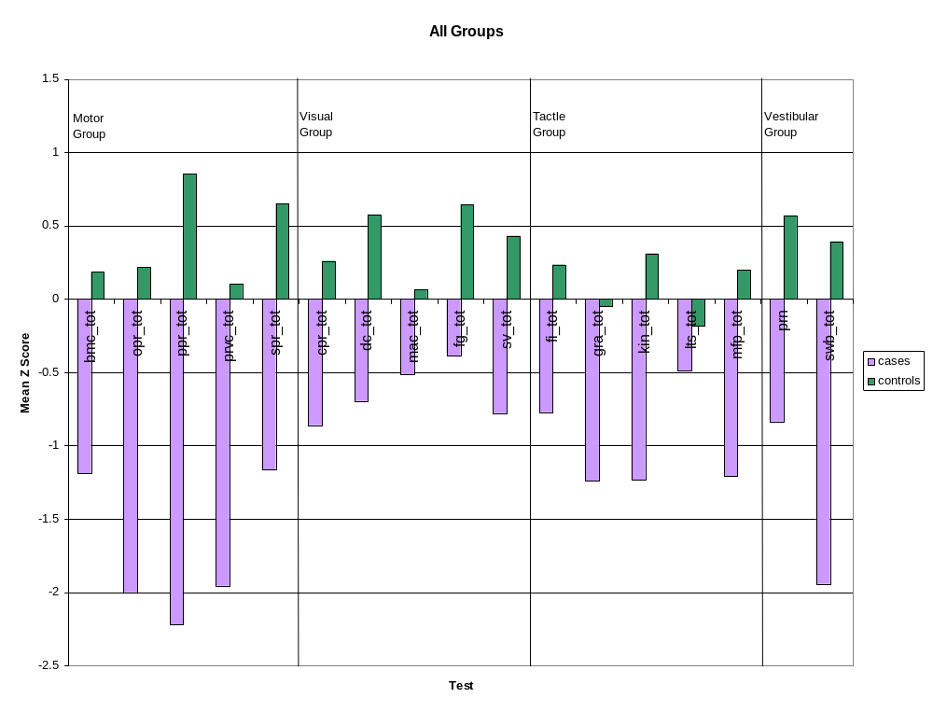

Slide 6
Results
All SIPT scores were significantly different between groups except Localization of Tactile Stimuli (LTS)
Conditional logistic regression identified Oral Praxis test as the best predictor of being in the autism group

Slide 7
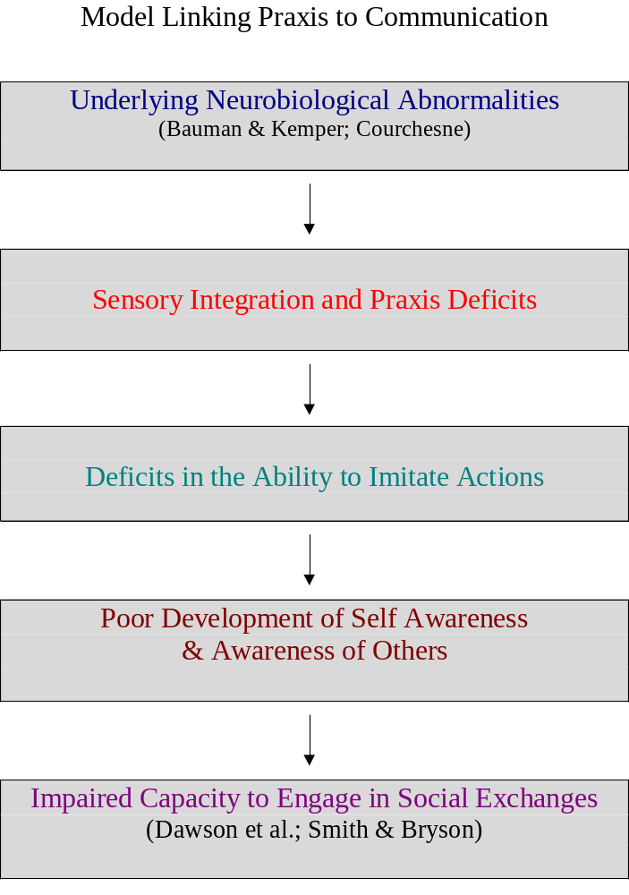
Model Linking Praxis to Communication

